Slide 1
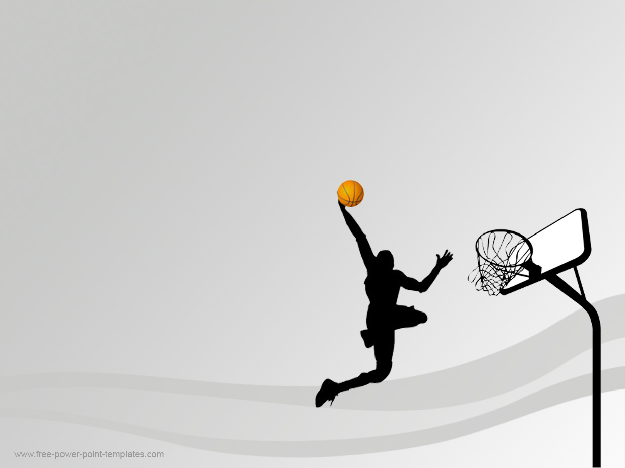
Assessment of Athletic Readiness Using CMJ Videos
CSE-641 Computer Vision
Group Name : HyperVision AI
Meet Patel (AU2444010)
Abhishek Gandhi (AU2444015)
Dhruvi Dalal (AU2444019)

Slide 2

Problem Statement
Athletic readiness is crucial for optimizing performance and preventing injuries in collegiate basketball.
• Countermovement Jumps (CMJs) are commonly used to assess fatigue and performance levels.
• The objective is to analyze CMJ videos and extract key performance indicators.
• Identify the correlation between extracted features and athlete readiness and to develop a predictive model to assess readiness.

Slide 3
Instructor’s Feedback
Instructed to check the RSI mod score using the mean demographic values from the paper as reference.

Slide 4
Working & Methodology
Setup & Initialization
Video Frame Processing
Resource Cleanup
Post-Processing Analysis
Results
Configure & Initialize
Set parameters, start MediaPipe Pose, open video, and prepare data lists.
Start Video Loop, Read Frame & Timestamp
Detect Pose, Extract Key Features, Store Frame Data, Calculate Hip Velocity, Detect Takeoff/Landing, Visualize Frame
Release Resources
Close the video file and destroy display windows after the loop finishes.
Identify Valid Jumps, Compute Jump Statistics
Calculate height, flight time, RSImod, knee angles, power etc., for each valid jump pair.
Print Results, Save Results

Slide 5
Working & Methodology
Jump Height:
h = (y_takeoff - y_peak) ×
HEIGHT_CONVERSION_FACTOR
Power Output:
P = (mass × gravity × h) / t_flight
Flight Time: t_flight = t_landing - t_takeoff
Eccentric Phase:
t_eccentric = t_peak - t_takeoff
RSImod:RSImod = h / t_flight
Concentric Phase:
t_concentric = t_landing - t_peak
Average Takeoff Velocity: v = Δy / Δt

Slide 6
Results
JUMP 1
JUMP 2
JUMP 3
Jump Height (m): 0.163
Flight Time (s): 0.467
RSImod: 0.35
Peak Knee Angle (deg): 177.5
Eccentric Duration (s): 0.233
Concentric Duration (s): 0.233
Max Velocity (m/s): 1.239 Power Output (W): 240.3
Jump Height (m): 0.148
Flight Time (s): 0.467
RSImod: 0.318
Peak Knee Angle (deg): 176.3
Eccentric Duration (s): 0.267
Concentric Duration (s): 0.2
Max Velocity (m/s): 1.096
Power Output (W): 218.2
Jump Height (m): 0.184
Flight Time (s): 0.533
RSImod: 0.344
Peak Knee Angle (deg): 177.9
Eccentric Duration (s): 0.3
Concentric Duration (s): 0.233
Max Velocity (m/s): 1.279
Power Output (W): 236.6

Slide 7
Future Scope
Train a Regression Model with Frontal View Data:Utilize existing frontal recordings for model training.
Incorporate Side-View Angle Measurements: Integrate side-view recordings to capture lateral angles.Use side angles to evaluate additional biomechanical features. Enhance overall posture analysis beyond the frontal view.
Adopt a Multi-View Analysis Approach: Combine frontal and side views into one framework. Gain a comprehensive 3D perspective on jump mechanics.Improve the accuracy of injury risk assessments.

Slide 8
References
[1] S. U. Sharma, S. Divakaran, T. Kaya, and M. S. Raval, “A computer vision framework on biomechanical analysis of jump
landings,” in Indian Conference on Computer Vision, Graphics and Image Processing (ICVGIP), 2024. [Online]. Available:
https://doi.org/10.1145/3702250.3702259
[2] S. Sharma, S. Divakaran, T. Kaya, C. Taber, and M. S. Raval,“A framework for biomechanical analysis of jump landings for
injury risk assessment,” in IEEE 28th Pacific Rim International Symposium on Dependable Computing (PRDC), 2023. [Online].Available: https://doi.org/10.1109/PRDC59308.2023.00052
[3] J. J. McMahon, T. J. Suchomel, J. P. Lake, and P. Comfort, “Understanding the key phases of the countermovement jump force-time curve,”Strength and Conditioning Journal, vol. 40, no. 4, pp. 96–106, 2018.
[4] G. Laffaye and P. Wagner, “Eccentric rate of force development determines jumping performance,” Computer Methods in Biomechanics and Biomedical Engineering, vol. 16, no. 1, pp. 82–83, 2013.
[5] A. P´erez-Castilla, F. J. Rojas, and A. Garc´ıa-Ramos, “Validity of a simple method for measuring force-velocity-power profile in countermovement jump,” International Journal of Sports Physiology and Performance,vol. 13, no. 2, pp. 200–207, 2018.
[6] “Selecting metrics that matter from cmj for performance profiling, neuromuscular fatigue monitoring, & injury rehabilitation testing,” Strength and Conditioning Journal, vol. 40, no. 4, pp. 1–10, 2018.

